Slide 1



INTERACTIVES-WORDS-IMAGES, VIDEO, AND ILLUSTRATIONS-PRESENTATION
DSA0504-Query Processing for Data science
CO 3-AT 2-TECHNICAL PRESENTATION
J.SUBHAASHREE
192424008

Slide 2
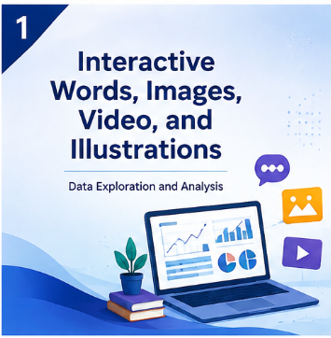
INTERACTIVE WORDS, IMAGES, VIDEO, AND ILLUSTRATIONS
A multimedia approach for presenting information effectively.
Combines text, graphics, videos, and illustrations.
Improves user engagement and understanding.
Makes data presentation more attractive and interactive.
Widely used in education, business, and digital platforms.

Slide 3
INTERACTIVE WORDS
Interactive words are clickable or dynamic text elements.
Examples include hyperlinks, buttons, labels, and tooltips.
Help users navigate through information easily.
Provide additional details when needed.
Increase readability and accessibility.
Improve user participation and engagement.

Slide 4

IMAGES AND ILLUSTRATIONS
Images visually represent ideas and concepts.
Illustrations simplify complex information.
Examples include diagrams, icons, charts, and infographics.
Improve the visual appeal of presentations.
Help users understand information quickly.
Increase attention and memory retention.

Slide 5

VIDEOS IN DATA PRESENTATION
Videos combine text, sound, images, and animations.
Used for tutorials, demonstrations, and presentations.
Explain difficult concepts in an easy manner.
Increase audience engagement and interest.
Support both visual and auditory learning.
Can be shared across multiple platforms.

Slide 6
CONCLUSION
Interactive media enhances communication and learning.
Words, images, videos, and illustrations make information easier to understand.
Multimedia elements improve user engagement.
Visual content simplifies complex data.
Interactive presentations are widely used in modern applications.
Effective use of multimedia improves knowledge sharing.

Slide 7
THANK YOU

Slide 8
